Slide 1
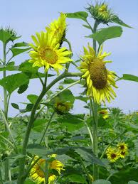
Welcome to everybody

Slide 2
Professor DR MD IDRIS ALI
Principal
Technical Teacher’s Traninig College
Tejgaon, Dhaka 1208

Slide 3
Subject: River Water Treatment
Topic: River Water treatment Plant.

Slide 4
Learning Outcomes:
Students will describe working principle of river intake.
Students will explain working principle and construction procedure of grit chamber, flocculation and sedimentation chamber.
Students will explain filter media and filtration process.

Slide 5
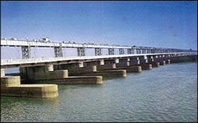
Barrage on the River Tista
Heavily Silted Water of the Tista River
Tista Barrage of Bangladesh

Slide 6
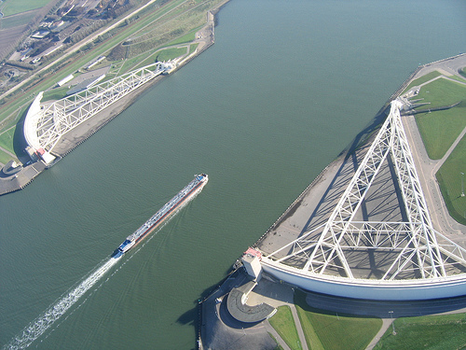
Water craft Control Gate

Slide 7
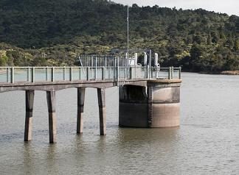
Stage Measurement Structure
Hydrograph Drawing and Analysis Station and Turbidity Measurement Station

Slide 8
River Water Treatment Plant

Slide 9
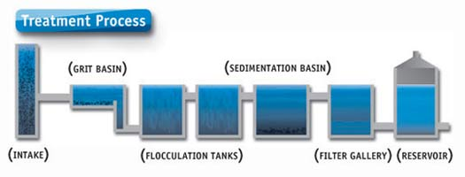
GRIT Chamber
Sedimentation Chamber
Storage tank
Intake Chamber
Flocculation Chamber
Filter Chamber

Slide 10
Systematic Diagram of a Water Treatment Plant

Slide 11
Home Work
Describe working principle of river intake.
Write down importance of grit chamber.
Write down and explain flocculation and flocculation chamber.
Draw and Write down various elements of River intake.
Explain sedimentation and sedimentation chamber.
Explain filtration of water after sedimentation.
Draw a flow diagram of the plant.

Slide 12
Thank you

